Slide 1

Policies and Value Functions
Notes:
1

Slide 2
Objectives
Recognize that a policy is a distribution over actions for each state,
Describe the roles of the state value and action value functions in reinforcement learning
Examples of policies and value functions for a given MDP
Policies and Value Functions
2
Notes:
2

Slide 3
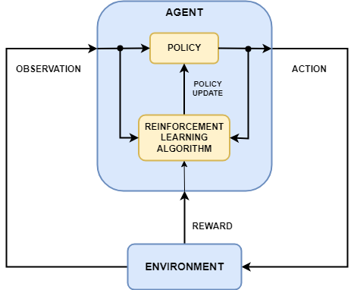
Policies
A policy in RL defines the mapping from states of the environment to actions that an agent should take.
It essentially determines the behavior of the agent within its environment.
3
Policies and Value Functions
Notes:
3

Slide 4
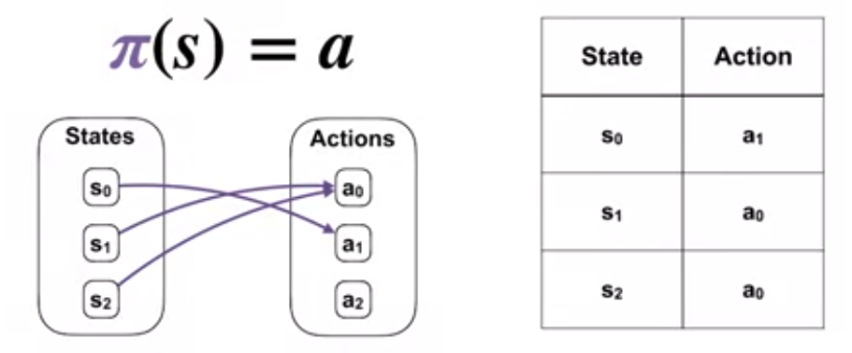
Policy types
Deterministic Policy:
In this type of policy, for each state, the agent selects a single action with certainty.
Mathematically, it can be represented as π(s) = a, where π is the policy, s is the state, and a is the action.
4
Policies and Value Functions
Notes:
4

Slide 5
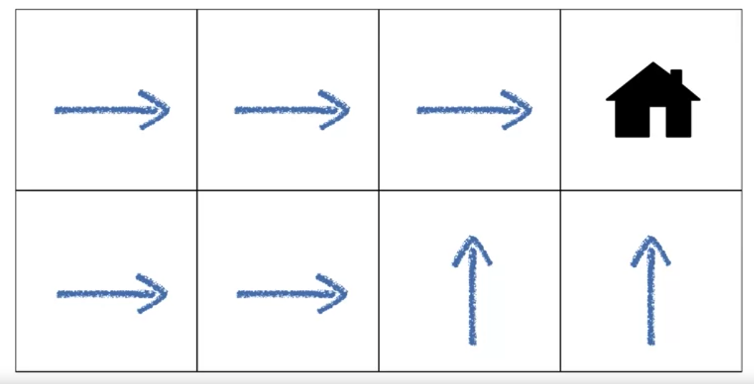
Deterministic Policy Example
An agent moves towards its house on a grid.
The states correspond to the locations on the grid.
The actions move the agent up, down, left, and right.
The arrows describe one possible policy, which moves the agent towards its house.
Each arrow tells the agent which direction to move in each state.
5
Policies and Value Functions
Notes:
5

Slide 6
Policy types
Stochastic Policy:
The agent selects actions based on a probability distribution over possible actions for each state.
This means that the agent's action selection is probabilistic rather than deterministic.
It is represented as π(a|s) = P(A=a|S=s), indicating the probability of selecting action a given state
6
Policies and Value Functions
Notes:
6

Slide 7
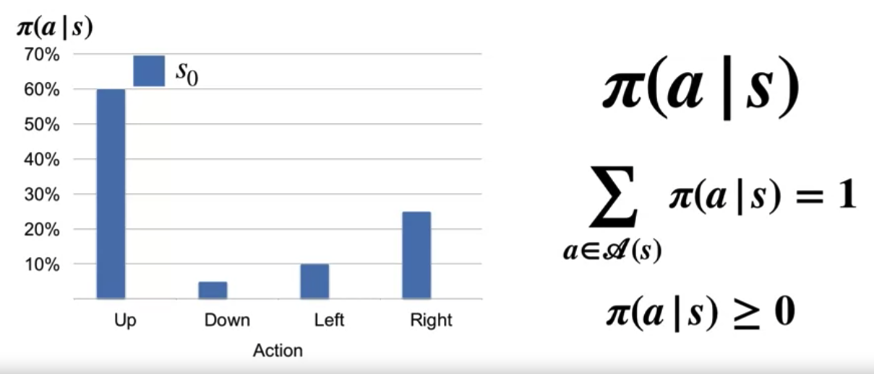
Policy type
Stochastic Policy:
The distribution over actions for state S0 according to Pi
Pi specifies a separate distribution over actions for each state.
The sum over all action probabilities must be one for each state
Each action probability must be non-negative.
7
Policies and Value Functions
Notes:
7

Slide 8
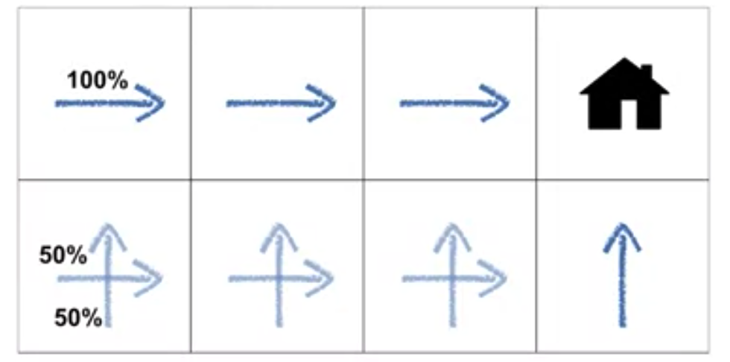
Stochastic Policy Example
A stochastic policy might choose up or right with equal probability in the bottom row.
The stochastic policy will take the same number of steps to reach the house as the deterministic policy.
8
Policies and Value Functions
Notes:
8

Slide 9
Value Function
The value function is a critical concept used to estimate the long-term rewards or expected return that an agent can achieve from a given state or state-action pair.
It helps the agent make decisions by providing a measure of how desirable it is to be in a particular state or to take a specific action from that state
9
Policies and Value Functions
Notes:
9

Slide 10

Value Function Types
State Value Function (V(s)):
The state value function predicts the expected return when starting from a particular state and following a specific policy thereafter.
Formally, it is defined as the expected sum of future rewards, discounted by a factor γ (gamma), when starting in state s and following policy π:
It represents how good it is for the agent to be in a given state under a particular policy.
10
Policies and Value Functions
Notes:
10

Slide 11

Value Function Types
Action Value Function (Q(s, a)):
The action value function predicts the expected return when starting from a particular state, taking a specific action, and then following a particular policy thereafter.
Formally, it is defined as the expected sum of future rewards, discounted by a factor γ, when starting in state s, taking action a, and following policy π thereafter:
It represents how good it is for the agent to take a particular action in a given state under a particular policy.
11
Policies and Value Functions
Notes:
11

Slide 12
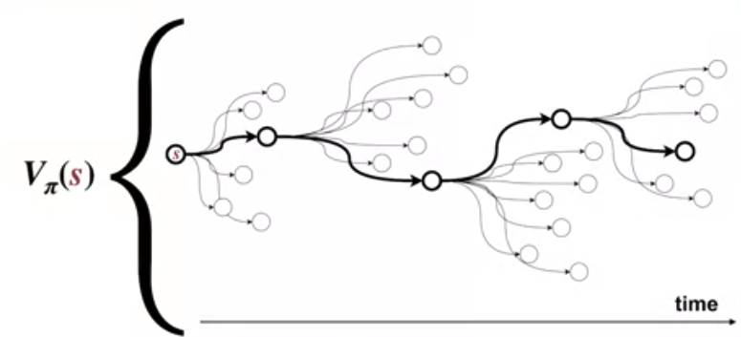
Value Function
Value function enable us to judge the quality of different policies.
It guides the agent's decision-making process. By estimating the value of different states or state-action pairs, the agent can select actions that maximize its long-term rewards
12
Policies and Value Functions
Notes:
12

Slide 13
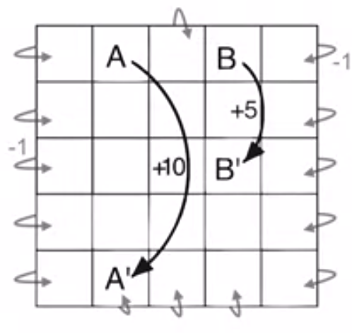
Value Function Example
A simple continuing MDP.
The states are defined by the locations on the grid, the actions move the agent up, down, left, or right.
The agent cannot move off the grid and bumping generates a reward of minus one.
Most other actions yield no reward.
13
Policies and Value Functions
Notes:
13

Slide 14
Value Function Example
A simple continuing MDP.
There are two special states however, these special states are labeled A and B.
Every action in state A yields plus 10 reward and plus five reward in state B.
Every action in state A and B transitions the agents to states A prime and B prime respectively.
14
Policies and Value Functions
Notes:
14

Slide 15
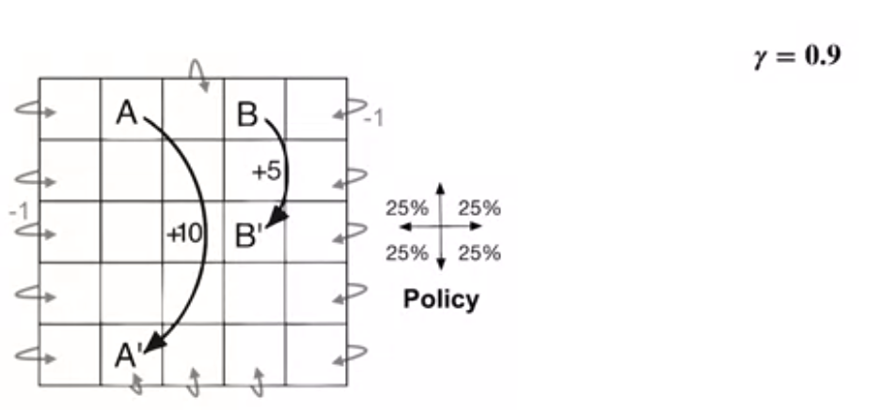
Value Function Example
A simple continuing MDP.
We must specify the policy before we can figure out what the value function is.
This is a continuing task, we need to specify Gamma= 0.9.
15
Policies and Value Functions
Notes:
15

Slide 16
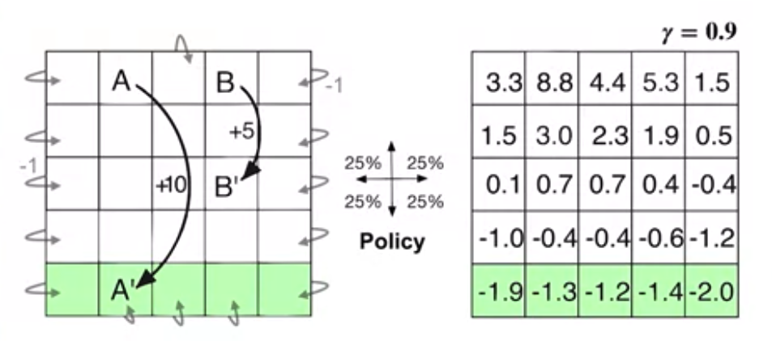
Value Function Example
A simple continuing MDP.
The value of each state is shown in the table.
The negative values near the bottom, these values are low because the agent is likely to bump into the wall before reaching the distance states A and B.
16
Policies and Value Functions
Notes:
16

Slide 17
Value Function Example
A simple continuing MDP.
A and B are both the only sources of positive reward in this MDP.
State A has the highest value: every transition from A moves the agent close to the lower wall and near the lower wall, the random policy is likely to bump and get negative reward.
17
Policies and Value Functions
Notes:
17

Slide 18
Value Function Example
A simple continuing MDP.
The value of state B is slightly greater than five.
The transition from B moves the agent to the middle.
In the middle, the agent is unlikely to bump and is close to the high-valued states A and B.
18
Policies and Value Functions
Notes:
18

Slide 19
Value Function Example
The grid world as a 3x3 grid where the agent can move up, down, left, or right, and each cell has a reward associated with it.
19
Policies and Value Functions
Notes:
19

Slide 20
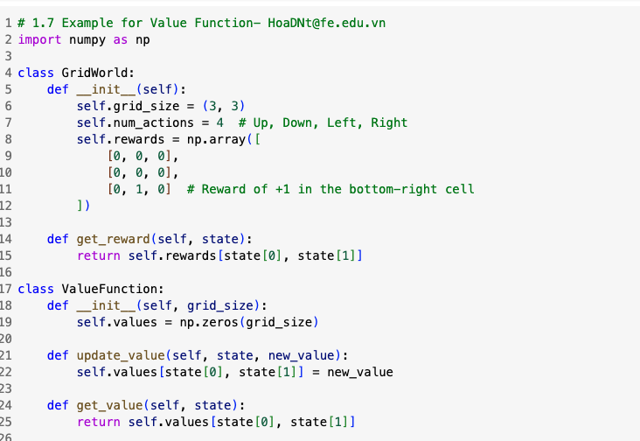
Value Function Example
20
Policies and Value Functions
Notes:
20

Slide 21
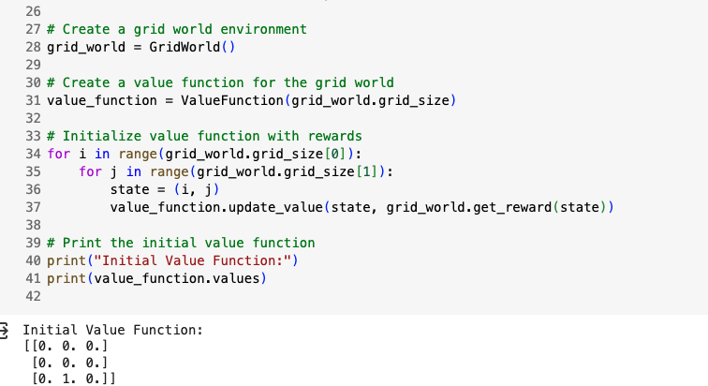
Value Function Example
21
Policies and Value Functions
Notes:
21

Slide 22
Summary
Recognize that a policy is a distribution over actions for each state,
Describe the roles of the state value and action value functions in reinforcement learning
Examples of policies and value functions for a given MDP
Policies and Value Functions
22

Slide 23
Q & A
Policies and Value Functions
23

